Slide 1




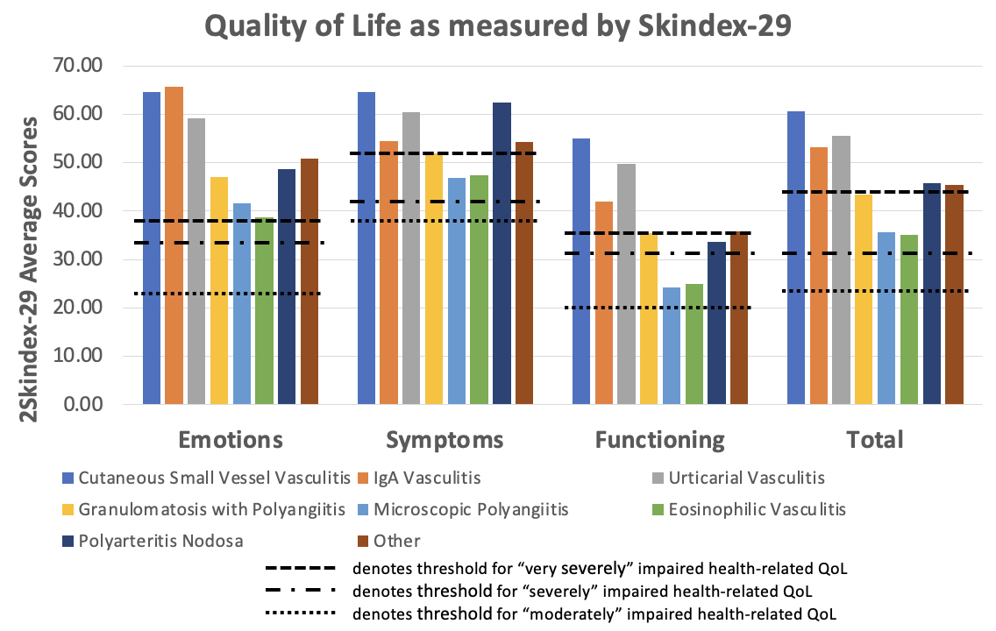
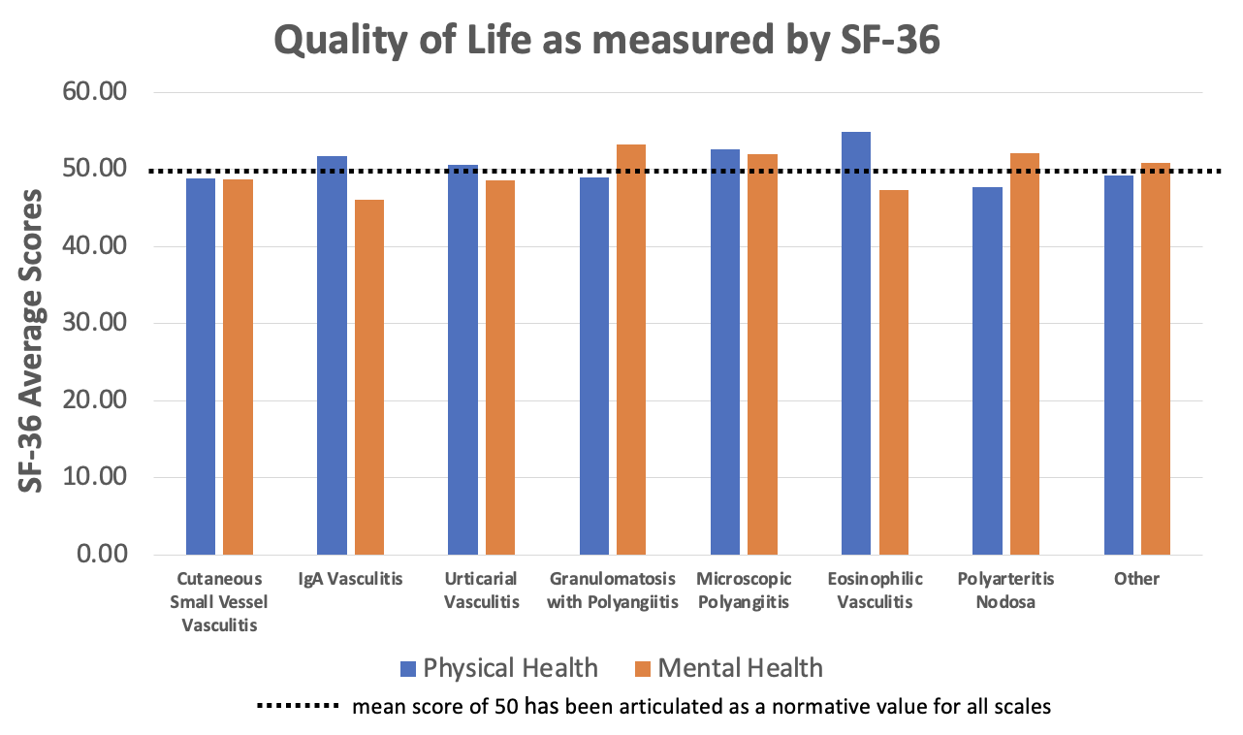
Impact of Cutaneous Vasculitis on Quality-of-Life: Findings from the VascSkin Study and the Vasculitis Patient-Powered Research Network
Sarah Mann, MD¹, Aamir Hussain, MD², Anisha B. Dua, MD, MPH³, Angelina Patrone, BA⁴, Kalen Larson, MA⁵, Peter A. Merkel, MD¹, MPH, Robert G. Micheletti, MD¹
1 – University of Pennsylvania, Philadelphia, PA USA, 2 – Georgetown University, Washington, DC USA
3 – Northwestern University, Chicago, IL USA, 4 – Patient Research Partner, Philadelphia, PA USA,
5 – Vasculitis Patient-Powered Research Network, Kansas City, MO USA
Introduction
For over 50% of patients, the impact of skin vasculitis on QoL was severe or very severe in all domains of the Skindex-29
Over 50% of patients had SF-36 scores less than the normative value of 50, indicating below average QoL
Table I: Patient Characteristics
 | Patients with Vasculitis
Total # of Unique Completed Surveys | 107
Female, N (%) | 90 (84%)
Mean Age, in years (SD) | 50.5 (16.1)
Disease Activity, N (%)
In Remission | 9 (8.4%)
Mildly Active | 45 (42.1%)
Moderately Active | 31 (28.9%)
Very Active | 22 (20.6%)
Years with the Disease
< 2 years | 11 (10.3%)
2-5 years | 28 (26.1%)
5-10 years | 34 (31.8%)
> 10 years | 34 (31.8%)
Vasculitis Subtype
Cutaneous Small-Vessel Vasculitis | 15 (14.0%)
IgA Vasculitis | 6 (5.6%)
Urticarial Vasculitis | 9 (8.4%)
Granulomatosis with Polyangiitis | 19 (17.6%)
Microscopic Polyangiitis | 11 (10.3%)
Eosinophilic Vasculitis | 16 (15.0%)
Polyarteritis Nodosa | 4 (3.7%)
Other | 27 (25.2%)
Cutaneous manifestations of vasculitis may cause itching, pain, ulceration, and psychosocial effects
However, the impact on quality-of-life (QoL) of skin vasculitis has not been systemically evaluated
Prior work on other skin diseases (e.g., chronic urticaria, psoriasis, hidradenitis suppurativa) demonstrate significant effects on QoL
This study assessed the quality-of-life of patients with cutaneous manifestations of vasculitis and evaluated factors affecting the patient experience
Emotions: n = 83 (78%)
Physical Health:
n = 60 (56%)
Symptoms: n = 84 (79%)
Functioning: n = 65 (61%)
Mental Health:
n = 56 (52%)
Overall: n = 81 (76%)
Methods
Study Design: Survey study disseminated through the Vasculitis Patient-Powered Research Network (VPPRN)
Study Population: Adult patients with cutaneous manifestations of vasculitis
Data Collection:
Short Form Health Survey (SF-36)
Effects of Skin Disease on QoL Survey (Skindex-29)
Patient and disease-specific questions
T-tests | Skindex-29 |  | SF-36
Gender (M vs. F) | Emotions | p = 0.79 | Physical | p = 0.48
 | Symptoms | p = 0.12
 | Functioning | p = 0.80 | Mental | p = 0.79
 | Total | p = 0.72
Disease Severity (remission/mild vs. moderate/severe) | Emotions | p < 0.01* | Physical | p < 0.01*
 | Symptoms | p < 0.01*
 | Functioning | p < 0.01* | Mental | p = 0.15
 | Total | p < 0.01*
Disease Duration (< 2 years vs. > 2 years) | Emotions | p = 0.03* | Physical | p = 0.78
 | Symptoms | p = 0.33
 | Functioning | p = 0.02* | Mental | p = 0.61
 | Total | p = 0.02*
Results
234 responses were received. After eliminating duplicates and incomplete responses, 190 remained. Of these, 107 patients experienced active skin lesions within the preceding 4 weeks and were included for analysis.
The impact on QoL of skin vasculitis was severe in every domain of the Skindex-29 (symptoms, emotions, functioning, overall), and QoL was below average in 6/8 domains of SF-36.
There were no significant differences in QoL measures between male and female patients.
Impact on QoL was greater with increasing disease severity.
Analyzed by vasculitis type, cutaneous small-vessel vasculitis had an impact on QoL which met or exceeded that of other diseases, as assessed by both Skindex-29 and SF-36.
Conclusions
Administration of validated skin-specific and general health surveys to patients with cutaneous manifestations of vasculitis revealed diminished quality of life across multiple domains, suggesting skin vasculitis has a significant impact on health, wellbeing, patient symptoms, and self-perception of health.
The VPPRN is supported in part by the Vasculitis Foundation and GSK

