Slide 1
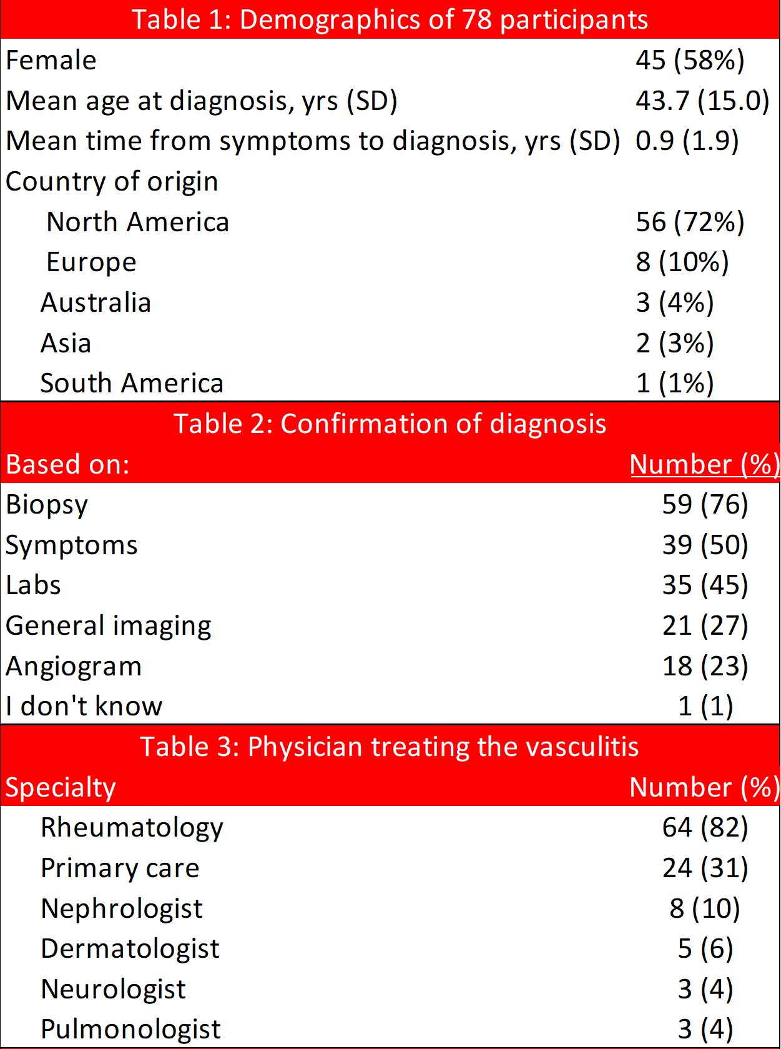
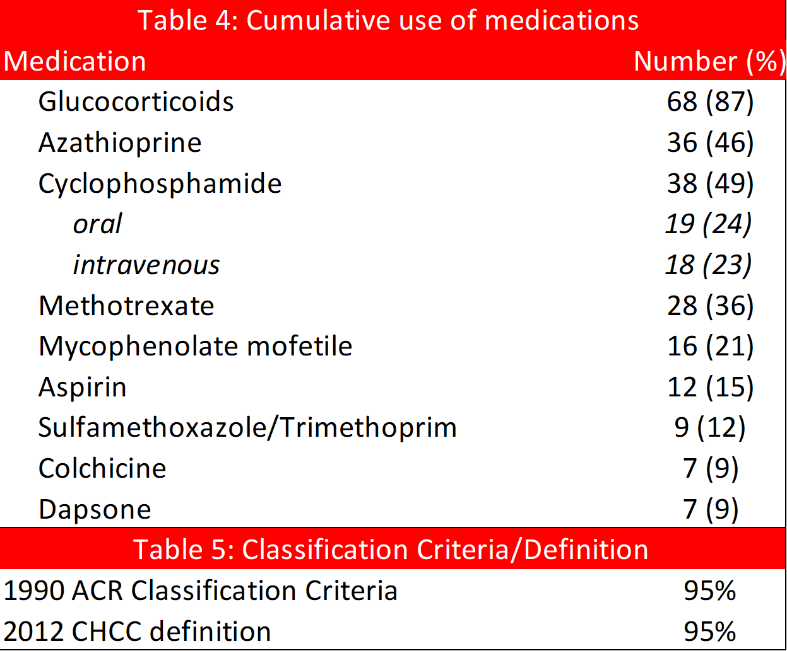
Description of an Internet-Based Cohort with a Self-Reported Diagnosis of Polyarteritis Nodosa
￼
Jason M Springer¹, Tanaz A Kermani², Dianne G Shaw³, Kalen Larson³, Cristina Burroughs⁴,
and Peter A. Merkel⁵, for the Vasculitis Patient-Powered Research Network
¹Vanderbilt University Medical Center, Nashville TN , USA; ²University of California Los Angeles, Los Angeles, CA, USA; ³Vasculitis Foundation, Kansas City, MO , USA; ⁴University of South Florida, Tampa, FL , USA; ⁵University of Pennsylvania, Philadelphia, PA , USA
OBJECTIVE
RESULTS
Describe an internet-based cohort of participants with a self-reported diagnosis of PAN and determine how many met established criteria for PAN
International cohort with patients from 5 continents (Table 1)
Reported manifestations included: joint pains (78%), nerve involvement (86%), muscle pain (86%), rash (76%), weight loss (62%), testicular pain in males (55%), hypertension (36%) and kidney involvement (33%).
Only 8% of cohort had isolated skin involvement.
The majority of patients reported confirmation of diagnosis by biopsy (76%). (Table 2)
METHODS
Prospective, internet-based, longitudinal registry of patients with a self-reported diagnosis of PAN
Data collection: Nov 2014--May 2020
All participants completed standardized forms including data on disease manifestations, diagnostic testing, and treatment.
Participants who reported a history of a positive test for ANCA (n=19) or hepatitis B (n=2) were excluded.
Cases of PAN were evaluated based on the 1990 ACR Classification Criteria and the 2012 CHCC Definition
CONCLUSIONS
Among patients with self-reported PAN:
Manifestations are similar to those from center-based cohorts.
Most patients meet either the 1990 ACR Classification Criteria or the CHCC definition of PAN.
These results support the use of online patient cohorts to conduct research in PAN.
ACKNOWLEDGEMENTS
The VPPRN is supported in part by the Vasculitis Foundation

