Slide 1
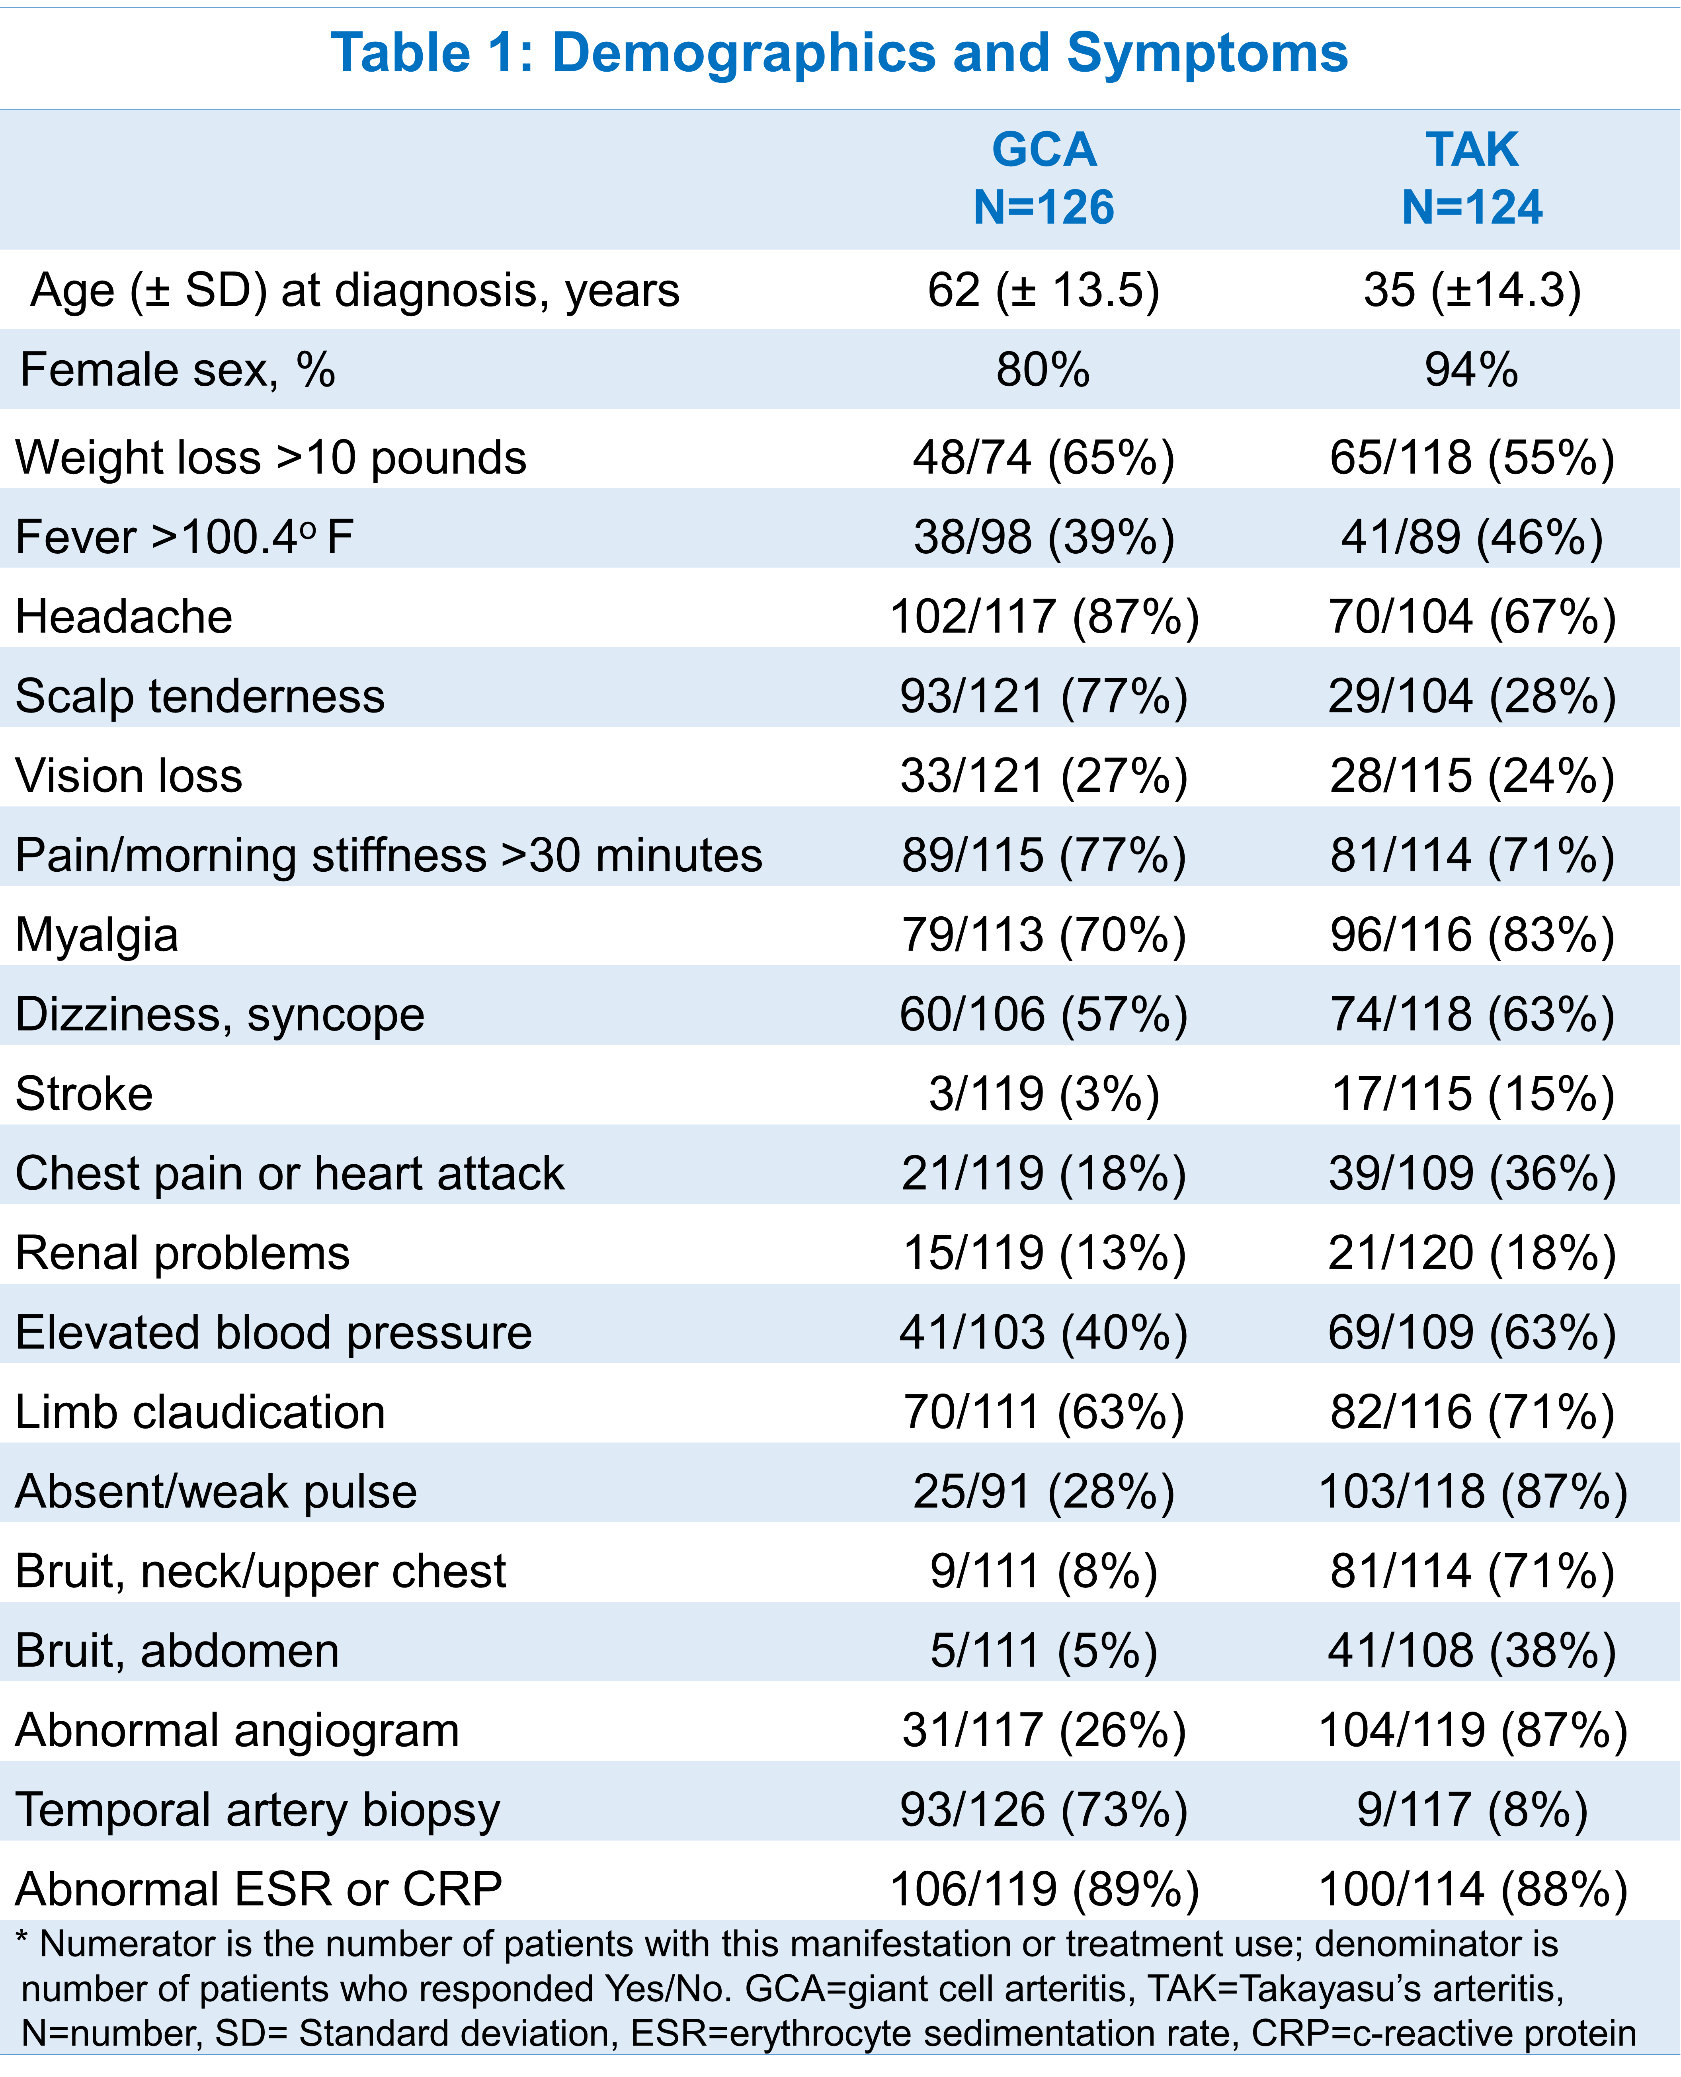
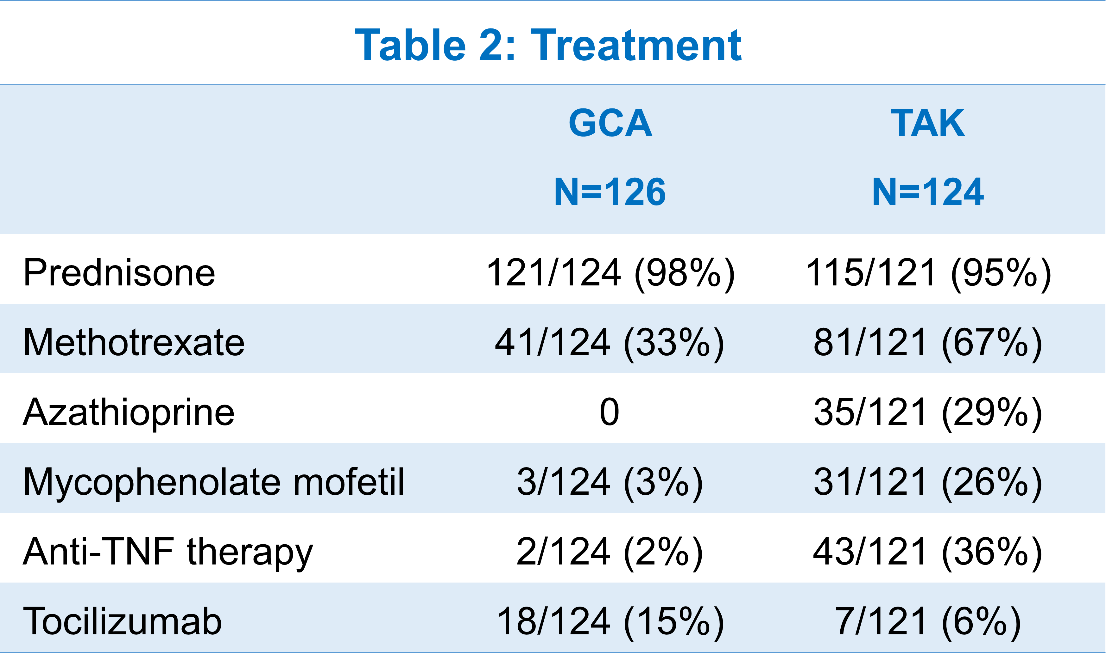
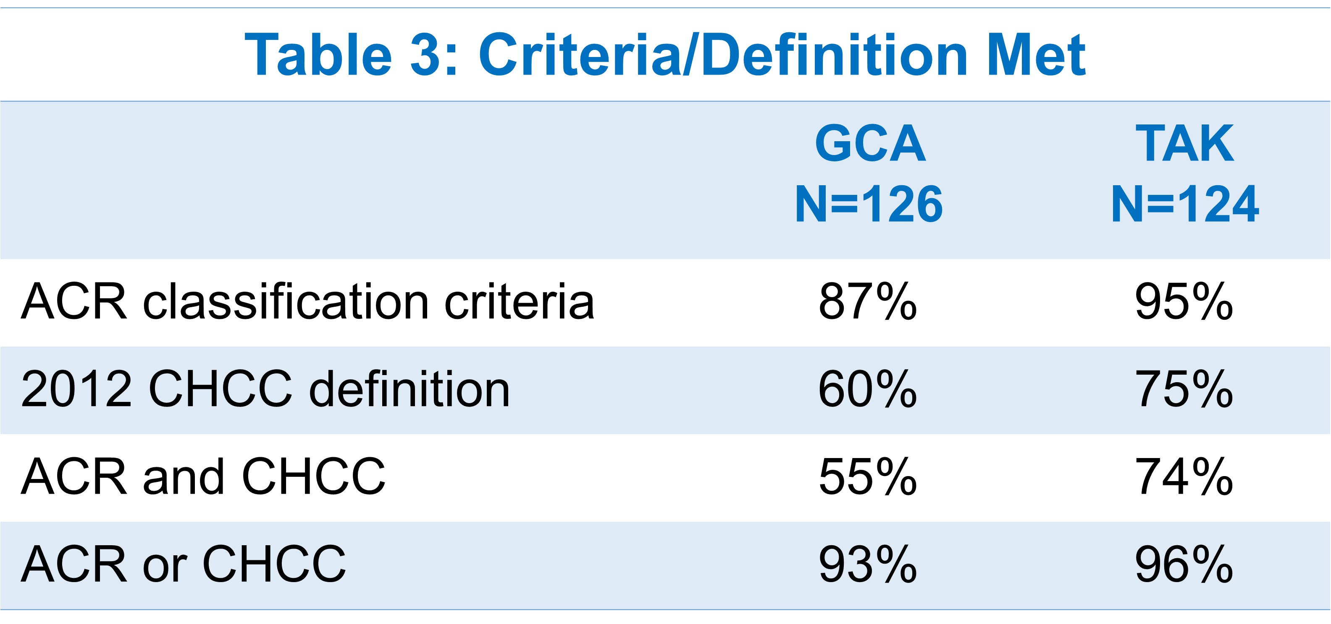
Clinical Characteristics and Reliability of a Self-Reported Diagnosis of Large-Vessel Vasculitis
￼
Tanaz A Kermani¹, Jason M Springer², Dianne G Shaw³, Kalen Larson³, Cristina Burroughs⁴,
and Peter A. Merkel⁵, for the Vasculitis Patient-Powered Research Network
¹University of California Los Angeles, Los Angeles, CA, USA; ²Vanderbilt University Medical Center, Nashville TN , USA; ³Vasculitis Foundation, Kansas City, MO , USA; ⁴University of South Florida, Tampa, FL , USA; ⁵University of Pennsylvania, Philadelphia, PA , USA
OBJECTIVE
CONCLUSIONS
To compare the clinical characteristics and determine the reliability of a self-reported diagnosis of giant cell arteritis (GCA) or Takayasu’s arteritis (TAK) in an international, internet-based cohort.
Given the rarity of vasculitis, there is an unmet need to evaluate alternatives to traditional multicenter studies.
Patients with GCA and TAK reliably provide information about their condition.
Manifestations of vasculitis, diagnostic studies, and treatments reported by patients with GCA and TAK are consistent with what is expected for these diseases.
Over 90% of patients with GCA or TAK report data establishing their diagnosis through criteria or definitions routinely used in clinical research.
These results provide strong support for the feasibility of conducting research in these rare diseases through online registries.
METHODS
Patients with GCA and TAK enrolled in the Vasculitis Patient Powered Research Network (VPPRN), an international, internet-based cohort of patients with 11 forms of vasculitis.
Participants provided data on demographics, symptoms, type of vasculitis, diagnostic studies, treatments.
We evaluated the proportion of patients who met either of the 1990 American College of Rheumatology (ACR) classification criteria for GCA (modified to include imaging) or TAK, or, the 2012 Chapel Hill Consensus Conference (CHCC) definitions for GCA and TAK.
RESULTS
73% of patients with GCA reported diagnosis by biopsy; 87% patients with TAK reported diagnosis by imaging (Table 1).
Over 90% of patients with GCA or TAK met the ACR Classification Criteria or CHCC definitions (Table 3).
ACKNOWLEDGEMENTS
The VPPRN is supported in part by the Vasculitis Foundation

